Slide 1
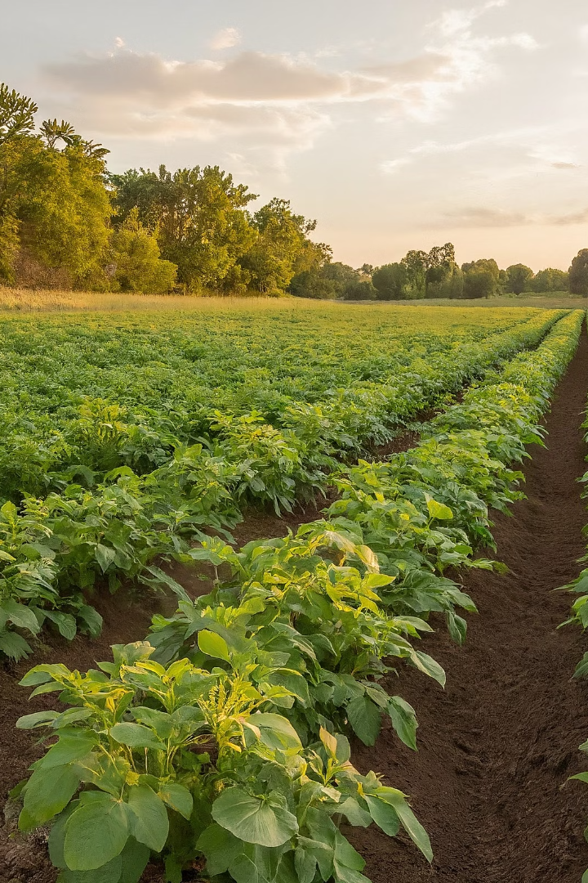
Introduction to the "Potato Disease Prediction" Project
Potato farmers face the constant challenge of identifying and managing crop diseases. This innovative project aims to revolutionize potato farming by leveraging advanced machine learning algorithms to predict and mitigate crop diseases. This presentation explores how advanced machine learning techniques can revolutionize potato disease prediction, empowering growers to take proactive steps towards healthier crops.
by GURU VIJAY
Notes:
1

Slide 2
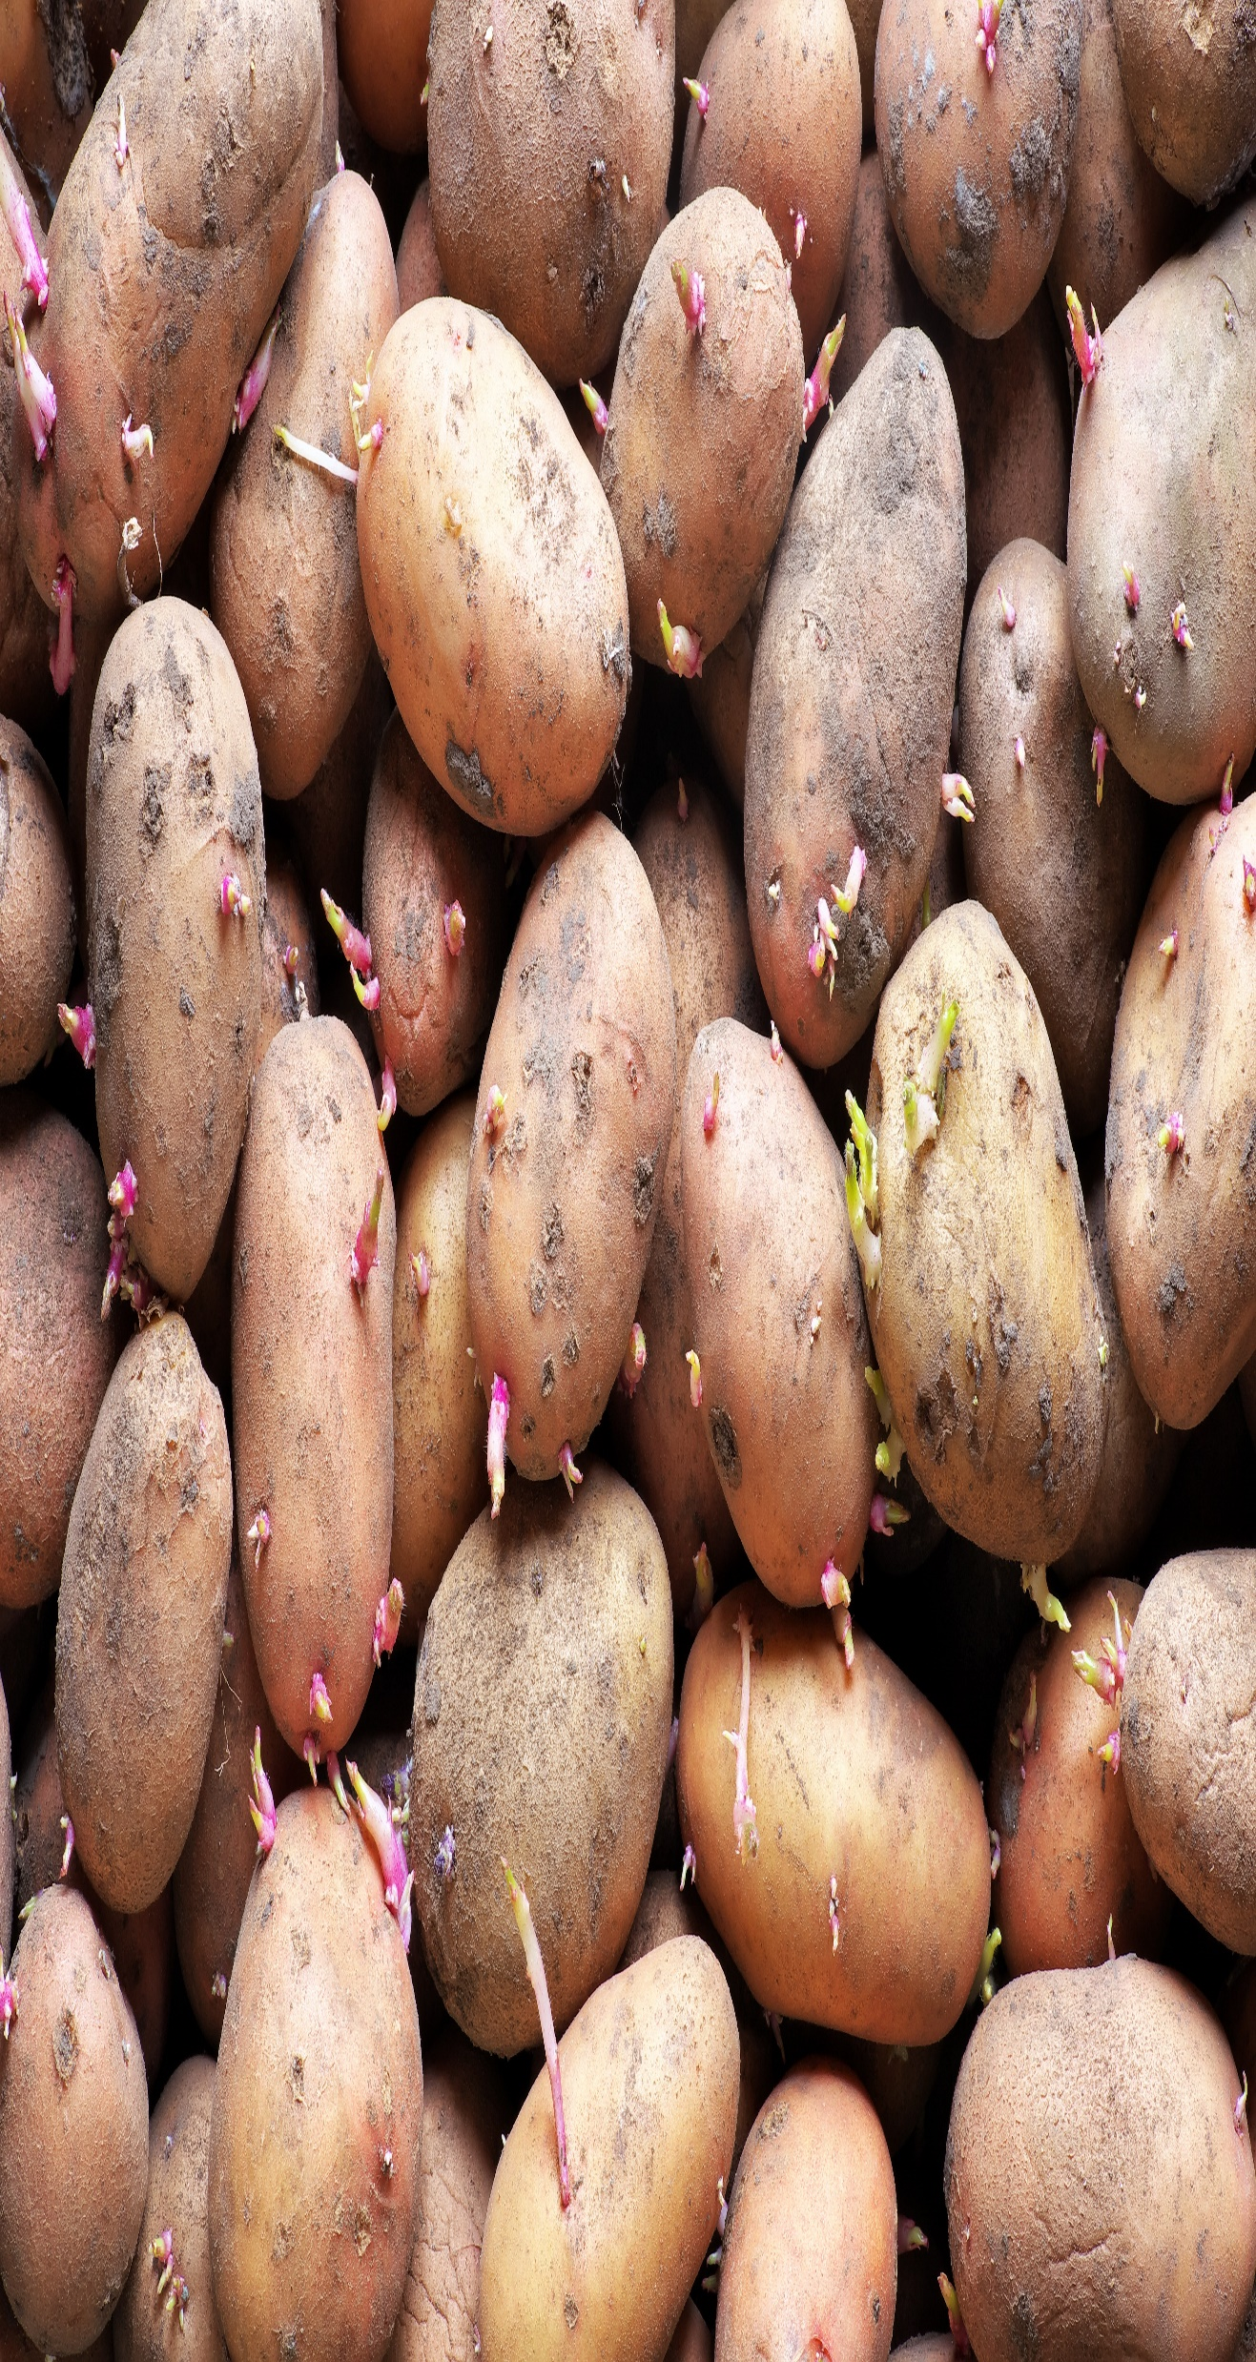
Importance of Disease Forecasting in Potato Farming
1
Early Detection
Accurate disease forecasting allows farmers to identify potential threats before they escalate, enabling timely intervention and prevention.
Reducing Crop Losses
Potato diseases, such as late blight caused by the Phytophthora infestans pathogen, can lead to significant crop losses if left unchecked. Disease forecasting helps farmers take proactive measures to mitigate the impact of diseases, thus minimizing crop losses and ensuring a higher yield.
2
3
Yield Optimization
Proactive disease management leads to healthier crops and higher yields, improving the overall productivity and profitability of potato farming.
Notes:
2

Slide 3
Leveraging Machine Learning for Disease Prediction
Data-Driven Approach
Predictive Algorithms
Continuous Learning
The project utilizes a diverse dataset, including historical crop records, environmental factors, and satellite imagery, to train advanced machine learning models.
State-of-the-art machine learning techniques, such as deep learning and ensemble methods, are employed to identify patterns and predict disease outbreaks with high accuracy.
The models are designed to adapt and improve over time, incorporating new data and feedback to enhance the reliability of disease forecasts.
Notes:
3

Slide 4
Integrating Agricultural Expertise and Data Analytics
Cross-Disciplinary Collaboration
Domain-Specific Insights
The project brings together a diverse team of experts, including agronomists, data scientists, and software engineers, to leverage their complementary skills and knowledge.
Agricultural experts provide invaluable insights into the biology and behavior of potato diseases, which are then incorporated into the machine learning models.
Contextual Understanding
By combining data analytics with practical farming experience, the team can develop more accurate and contextually relevant disease prediction models.
Notes:
4

Slide 5



Enabling Proactive Disease Management Strategies
Early Warning
The disease prediction models provide early alerts, allowing farmers to take proactive measures before outbreaks escalate.
Targeted Interventions
With the forecasted disease information, farmers can implement precise, tailored treatment strategies to protect their crops.
Resource Optimization
Proactive disease management helps reduce waste, minimize environmental impact, and improve the overall efficiency of potato farming operations.
Notes:
5

Slide 6



Optimizing Crop Yield through Timely Insights
Increased Yields
Cost Savings
Sustainable Practices
By mitigating disease risks, the project aims to help farmers achieve higher crop yields, improving overall productivity and profitability.
Targeted disease management strategies can lead to reduced input costs, such as pesticides and labor, further enhancing the economic viability of potato farming.
The project's focus on preventive measures and data-driven decision-making promotes more environmentally responsible farming practices.
Notes:
6

Slide 7
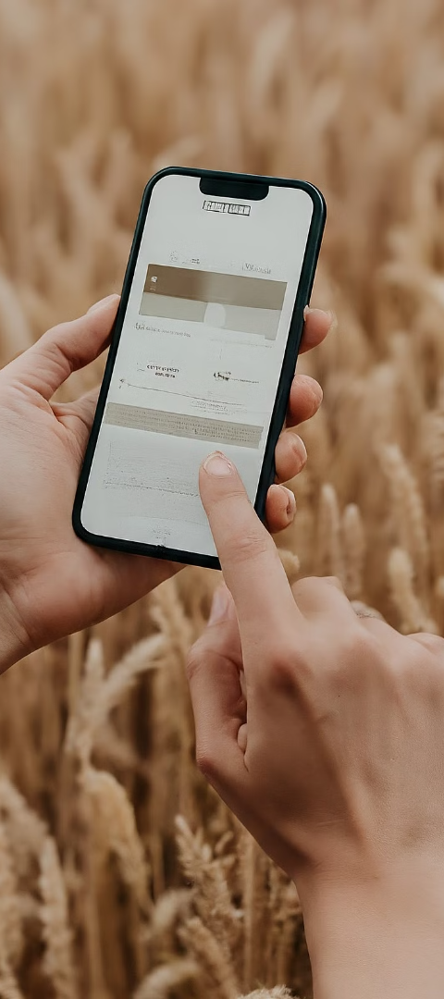
Real-time Disease Monitoring
Automated Scanning
Incorporating computer vision technology to continuously monitor potato fields and detect emerging disease symptoms.
2
Mobile Reporting
Developing user-friendly mobile applications that allow farmers to quickly upload and analyze images of their crops.
3
Early Warning System
Leveraging predictive models to provide timely alerts and notifications about potential disease outbreaks.
Notes:
7

Slide 8
Conclusion and Future Outlook
Conclusion
The "Potato Disease Prediction" project represents a significant step forward in leveraging data-driven solutions to address the challenges faced by potato farmers. By combining advanced machine learning with agricultural expertise, the team aims to empower farmers with timely insights and proactive disease management strategies, ultimately optimizing crop yields and promoting sustainable farming practices.
Notes:
8

